Slide 1
BIG DATA
Prepared by
Balaji.R

Slide 2
Big data
The dataset which satisfies the characters of 5V’s is called big data.
That it is difficult to process using Traditional data processing system.
It can handle large datasets when compared to RDBMS.

Slide 3
5 V’s of Big data
Volume – amount of data
Variety – different kinds of data
Velocity – rate at which data is produced
Veracity - Loss and recovery of data
Value - extracting useful data

Slide 4
HADOOP
It is a open source, java based framework that supports storing and processing of extremely large data sets.
Applications are written in high level programming language.
It consists of two architectures : 1.x,2.x.

Slide 5
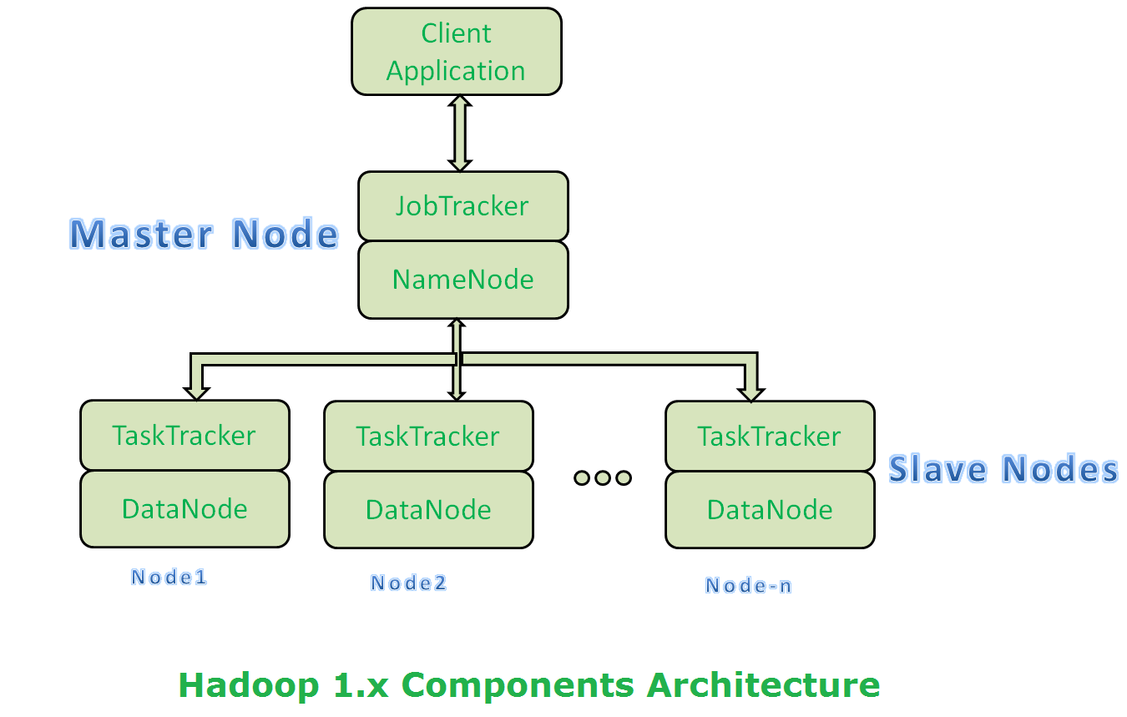
Architecture 1.x

Slide 6
HDFS
It is a distributed file system which is used for storing the datas.
It consists of following components.
Namenode : Stores metadata of the files.
Datanode : Stores the actual data in HDFS.

Slide 7
MAP REDUCE
It is used for processing the data.
It contains following components.
Job tracker : Allocates the job to nodes in cluster.
Task tracker : Accepts the tasks and perform the jobs.

Slide 8
LIMITATIONS
Single point of failure.
Low resource utilization, it contains only 4000 nodes.

Slide 9
Architecture 2.x
It consists of HDFS and YARN (MR 2).
HDFS consists of Namenode,Datanode,Secondary Namenode.
YARN consists of Resource manager,Node manager.
It also consists of Application master,container and scheduler.

Slide 10
Hadoop Ecosystem
Mapreduce
Hive
Pig
Sqoop
Flume
Oozie
Zookeeper

Slide 11
Map Reduce
It is a java framework which processes a large amount of datas in parallel on large clusters.
It consists of two main parts Mapper and Reducer.
It consists of four methods namely Setup,Map,run,Cleanup.

Slide 12
Mapper
It maps input key/value pairs to a set of intermediate key/value pairs.
The Output of the mapper is taken as input for reducer.

Slide 13
Sort and Shuffle
Sort phase covers the merging and sorting of map outputs.
Data from mapper are grouped together by key.
In shuffling the data is transferred from mapper to reducer.

Slide 14
Reducer
Reducer reduces a set of intermediate values which share a key to a smaller set of values.
The output from the mapper is taken as input for the reducer.

Slide 15
Hive
It is a strucutural query language in Hadoop used for implementing mapreduce functions.
A command line tool and JDBC driver are provided to connect users to hive environment.

Slide 16
Pig
Scripting language used for executing mapreduce functions.
Compared to mapreduce the codes are shorter and easier to execute.

Slide 17
THANK YOU

